Slide 1
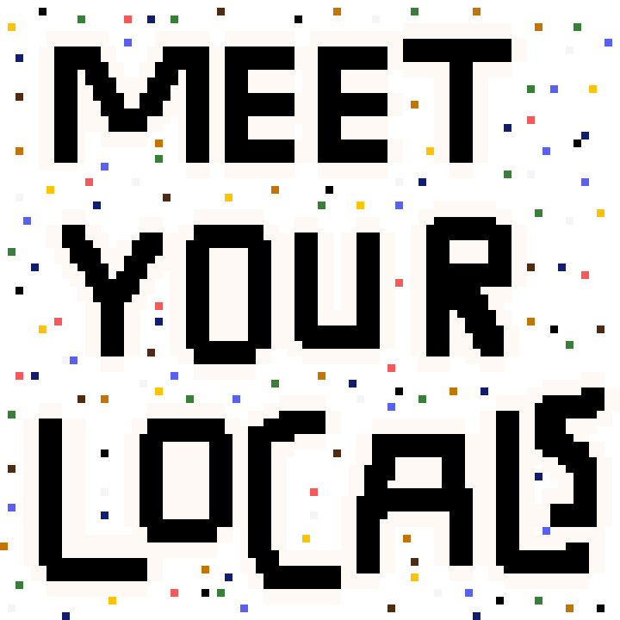

Slide 2
An Introduction to Locals

Slide 3
What are Locals?

Slide 4
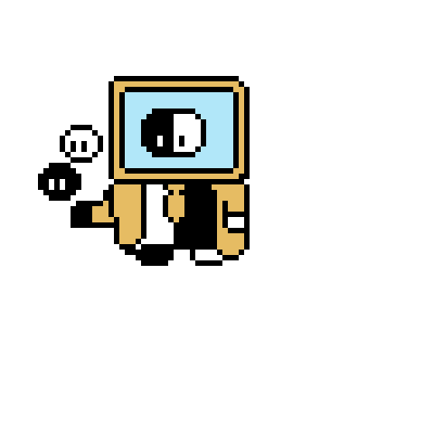
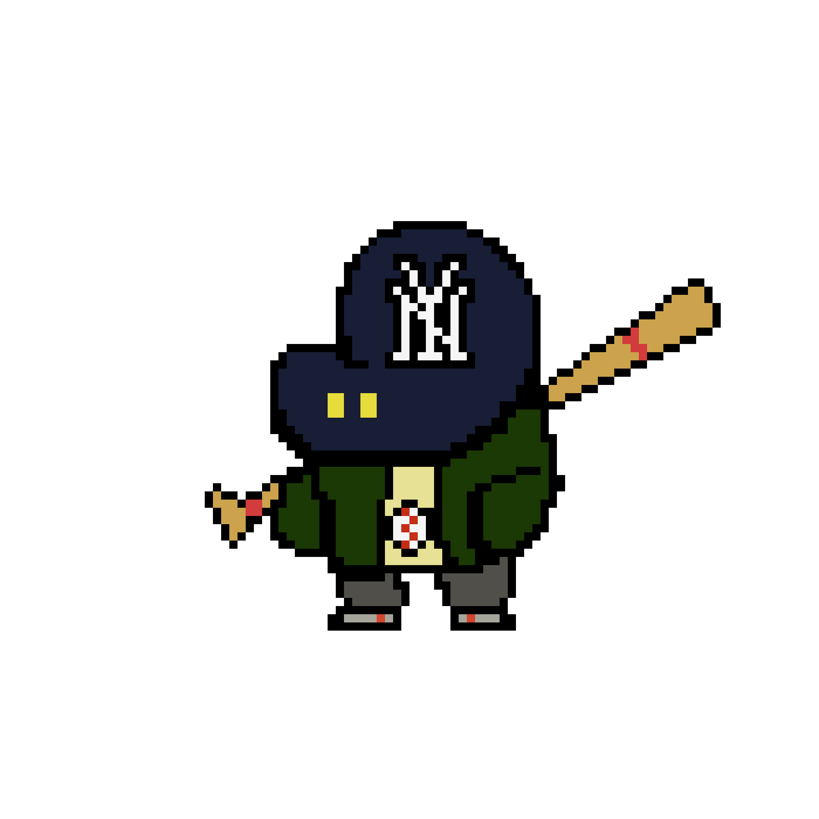
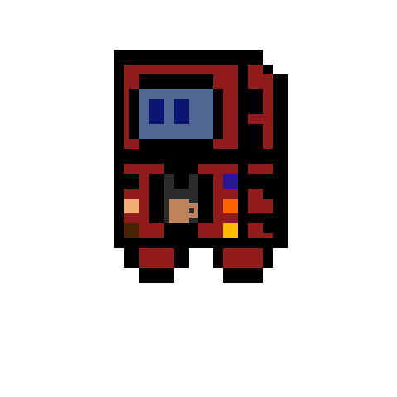
What are Locals?
Small characters found throughout the world
Can be
Natural (plants, animals)
Inanimate (computers, food, household objects)
Based on someone or something famous
Totally original

Slide 5
Where can I find Locals?

Slide 6
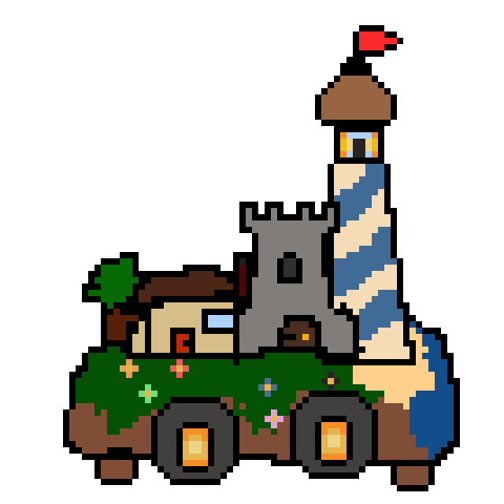
Where can I find Locals?
Businesses
Landmarks
Natural environments
Quiet corners of cities and towns
The hidden frontier (paper found here)
Anywhere people are or are not, is where you’ll find a Local!

Slide 7
How can I find Locals?

Slide 8
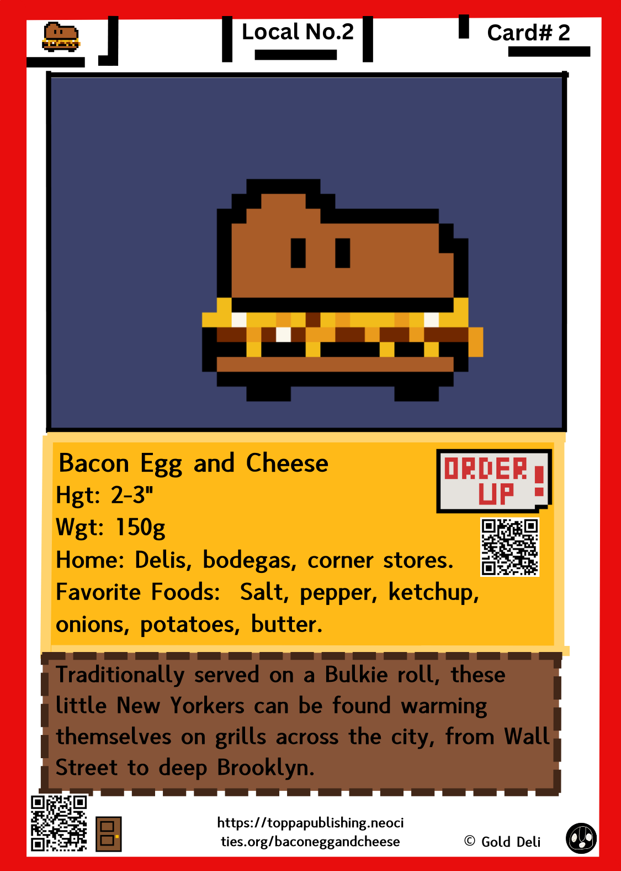
How do I find Locals?
A Local card
Doodles
A Local bridge

Slide 9
What’s next?

Slide 10
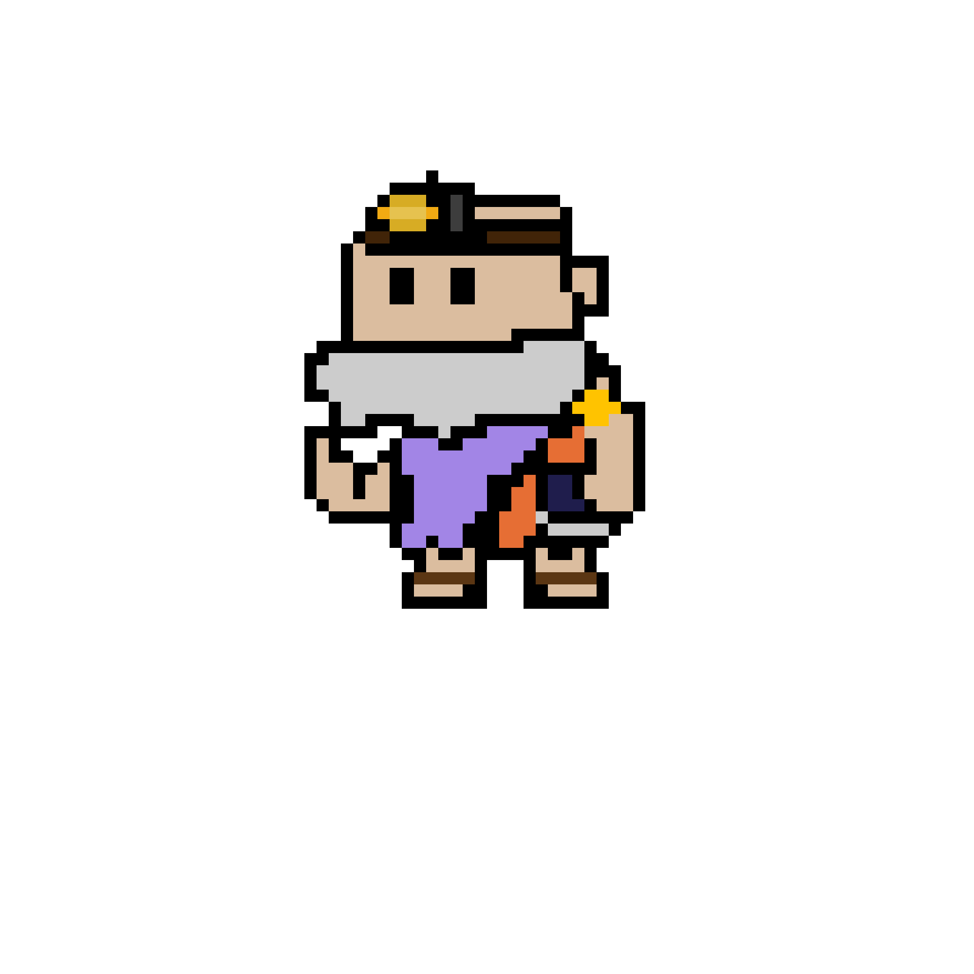
What’s next?
The first Local bridge is coming March 15th
New Locals released every Monday, Wednesday, and Friday.
Local cards will have select releases Spring 2025, and a wide release to the public Summer 2025.

Slide 11
Take care, and stay curious!

